Slide 1

Testing using SELENIUM AND TESTNG

Slide 2
Unit: Testing Nidhi Trivedi 201332

Slide 3
About project: Web page using
HTML/CSS
SELENIUM
Testing web page using selenium
Testing
Parallel testing organizing code

Slide 4

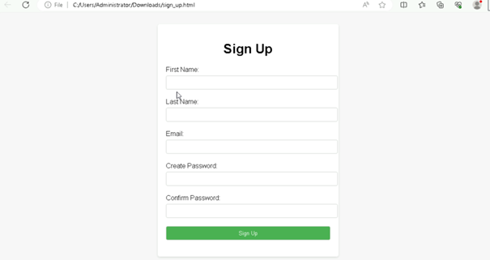
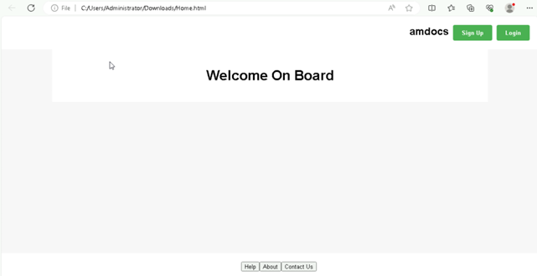
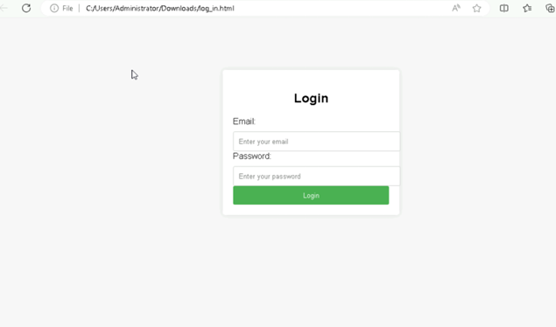
Web Pages

Slide 5

Selenium
Automation tool
Cross browser testing
Programming Language support
Open source

Slide 6
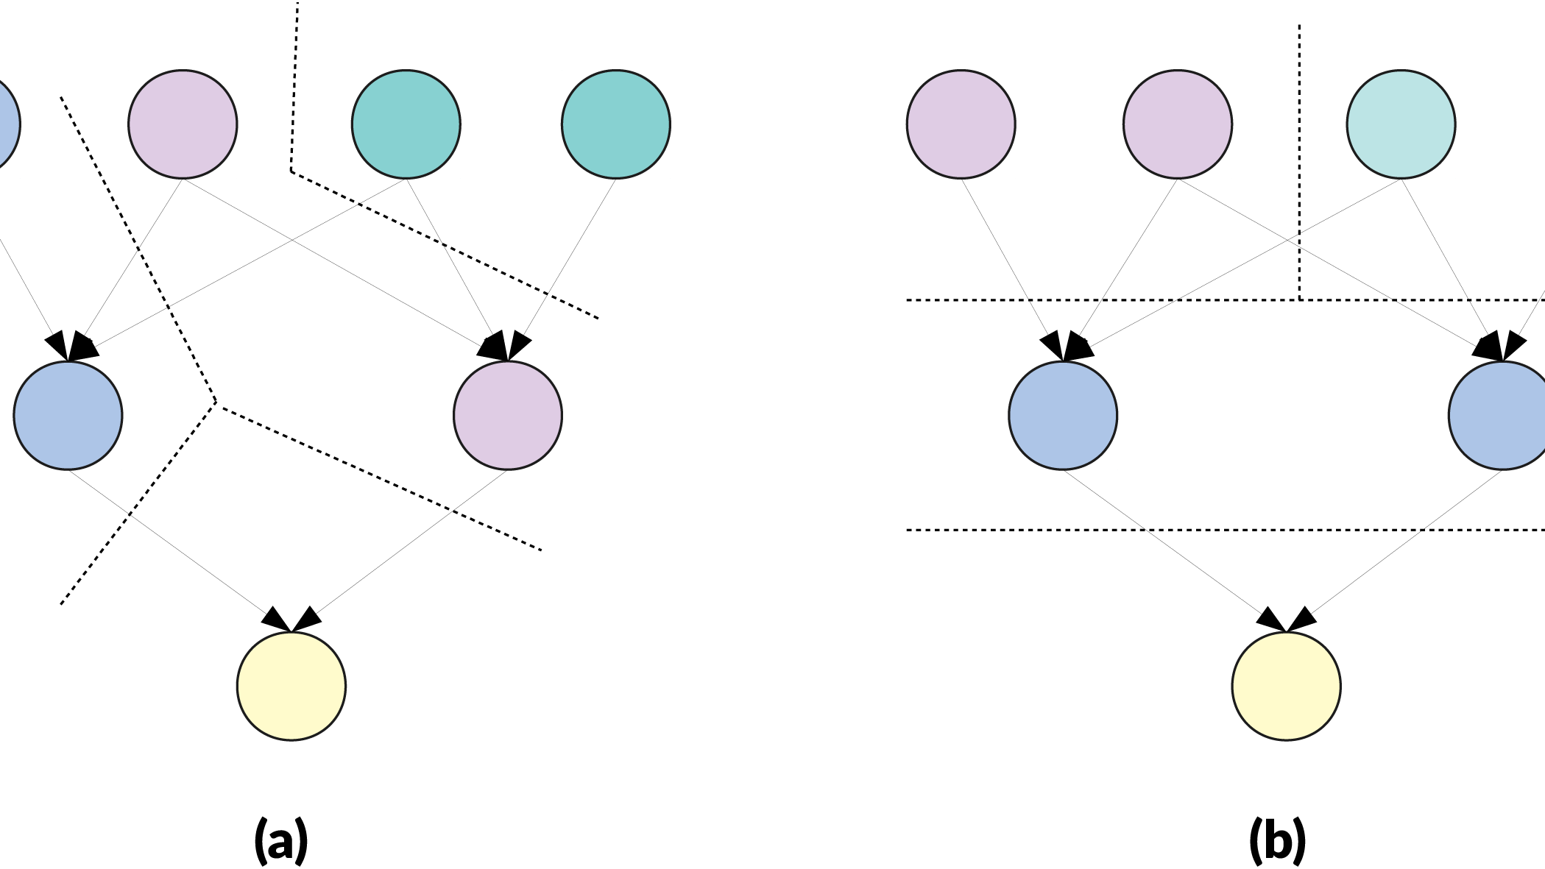
TestNG
Testing Framework
Annotation
Parallel test execution
Test suite configuration
This Photo by Unknown author is licensed under CC BY.

Slide 7

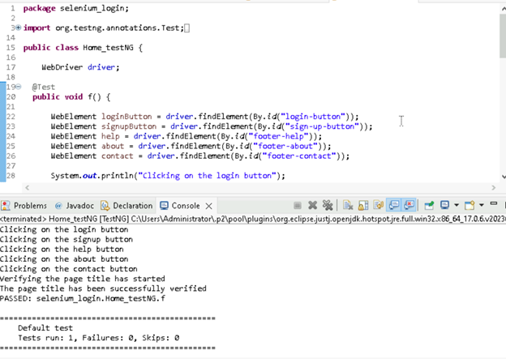
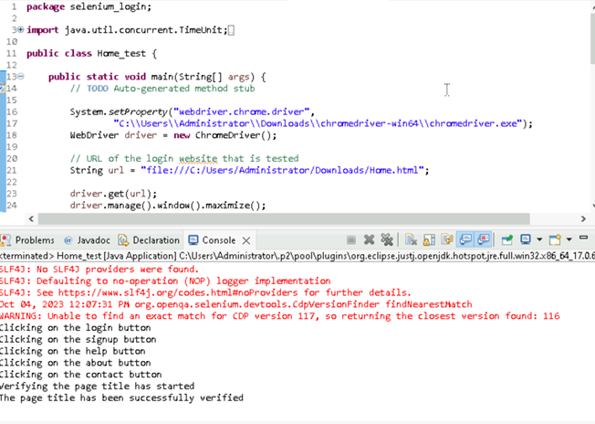
Home Page Testing:
TestNG Selenium

Slide 8

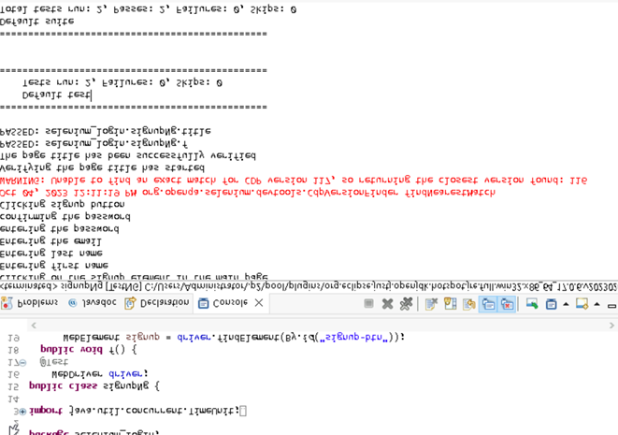
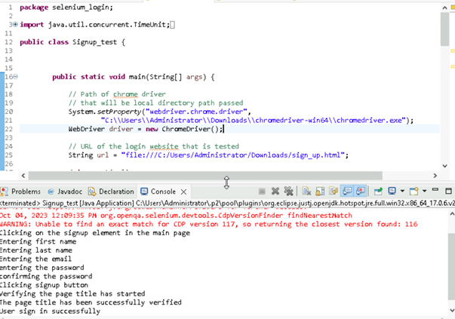
Signup page testing
TestNG Selenium

Slide 9
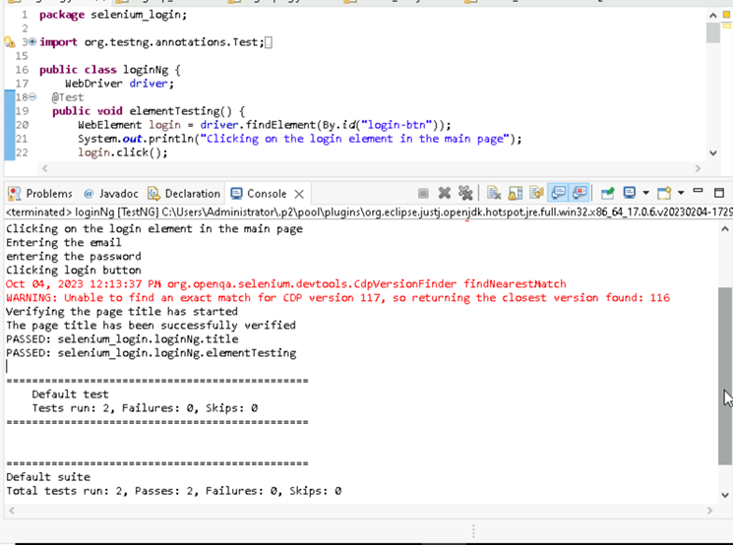
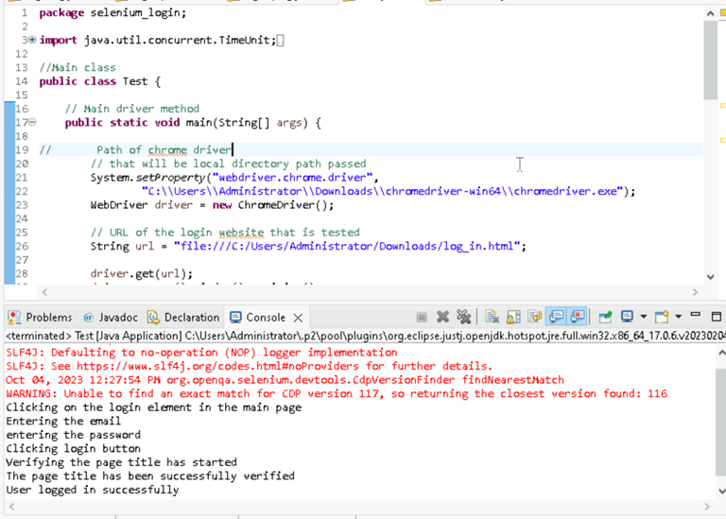
Log in page testing
TestNG Selenium

Slide 10

Thank You

